Slide 1


ECAD Viewer Development and Integration Insights: A Journey Through the Open Source Community
Ethan Chien
Intelligent Manufacturing Center, Huaqiu
Notes:
The photo at the bottom right was taken on a trip to Xiamen, a beautiful city.
Our gathering today is also a journey—a journey into the open-source community.

Slide 2
Talk outline
Give ECAD-Viewer a Try:
Online Design Viewer
AI-Powered Design Interaction
Roadmap
Integration and Development
Architecture of ECAD-Viewer
Integrating ECAD-Viewer To Your Website
Development Stories with the Open Source Community
Notes:
While I introduce how to share your designs on the web using ECAD-Viewer and demonstrate how to integrate it into your own website, I’ll also guide you through the development stories behind this project.

Slide 3
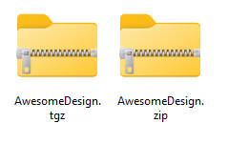
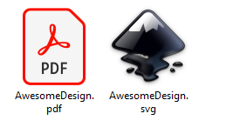
How to Share Designs for Documentation and Review
AwesomeDesign
Notes:
When I ask colleagues or companies to share their designs, I usually receive a zip file, which I then have to open in desktop EDA software—even if I don’t intend to modify it.
For documentation, SVG or JPG images are common formats, but they often lack the item properties I need.
With ECAD-Viewer, you can share your design with just a single link.

Slide 4
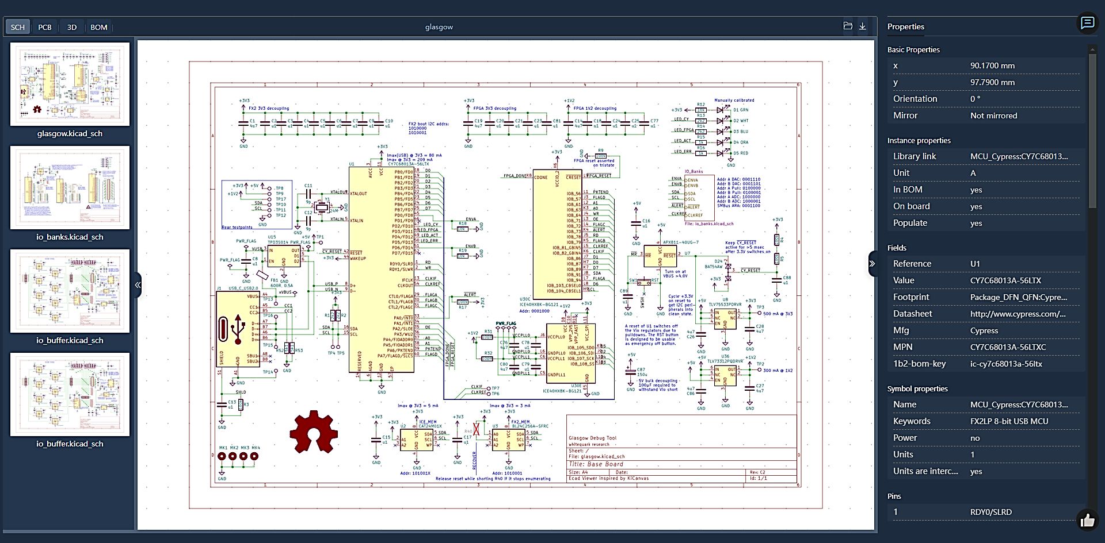
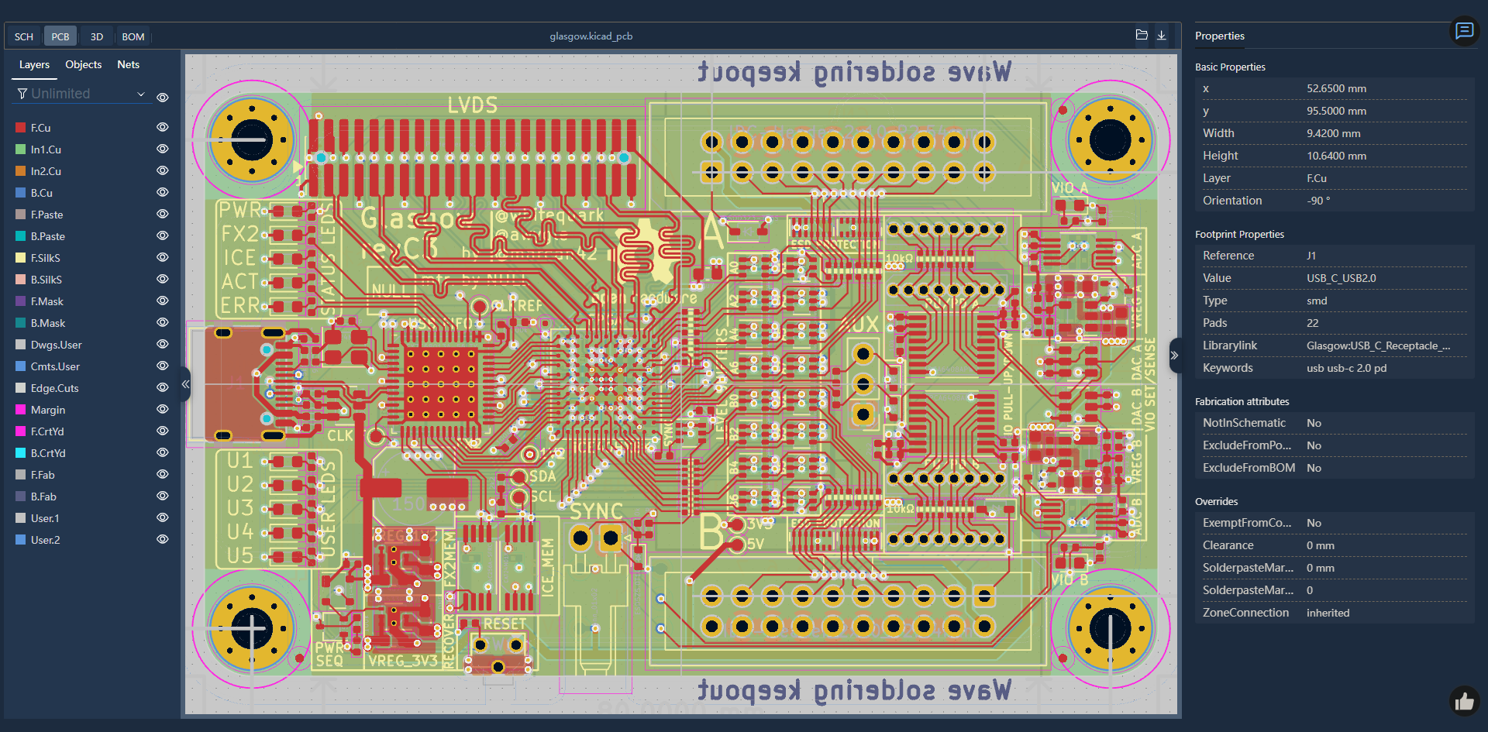
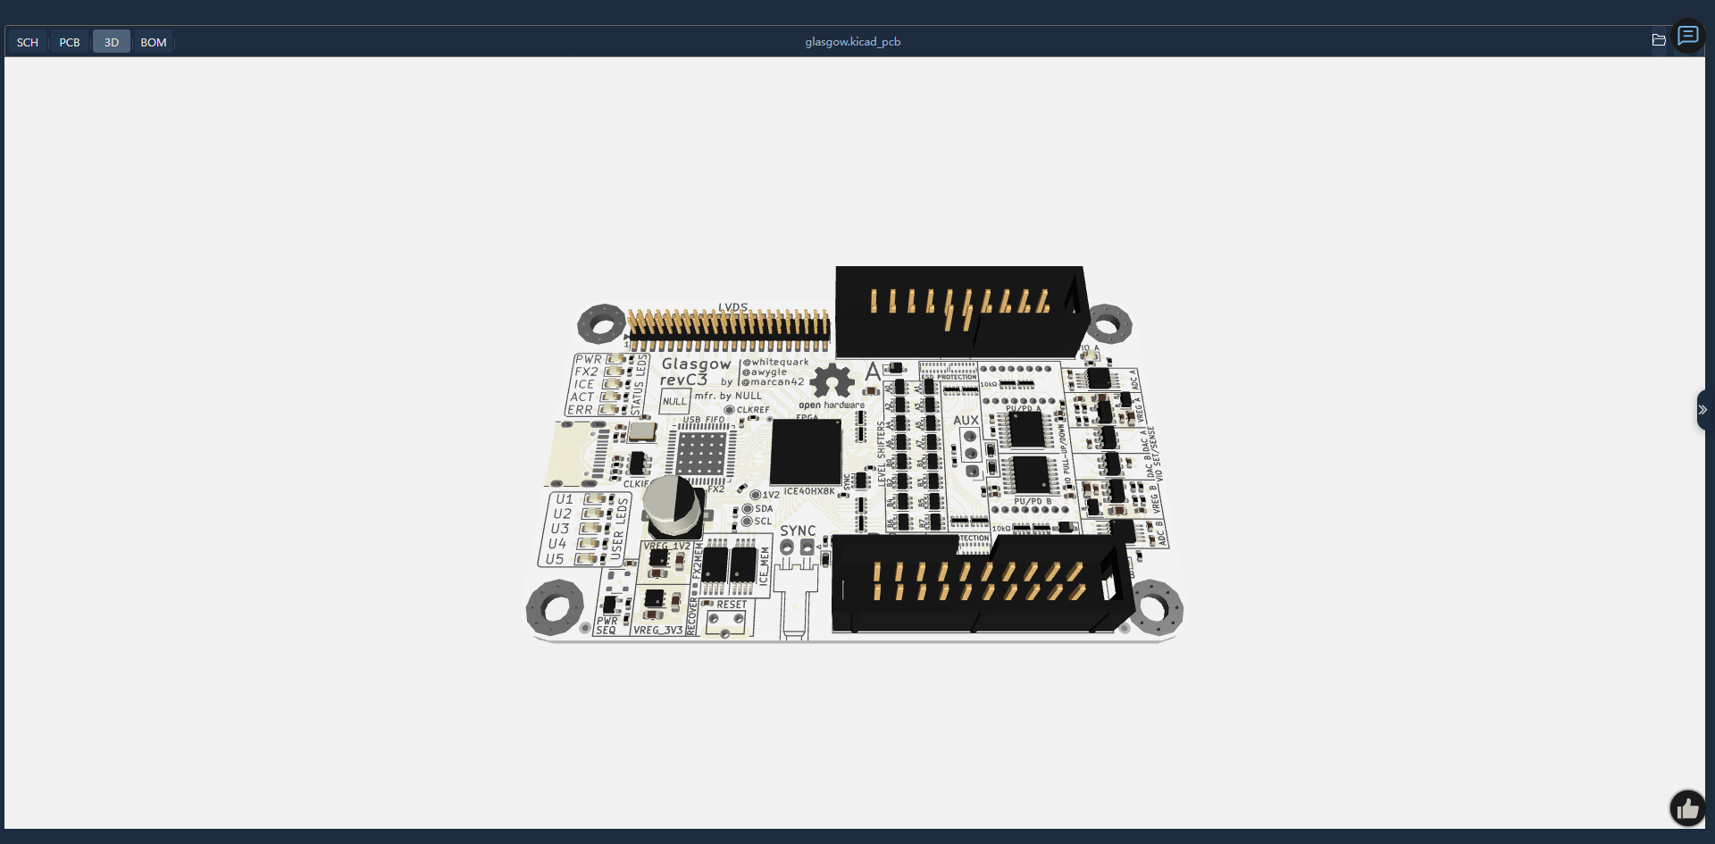
Notes:
They will see your interactive awesome design with all the information as soon as they open the link.

Slide 5

No One Is Experienced at the Beginning
Notes:
Watching my previous manager type was like attending a concert—he played the keyboard like a piano virtuoso.
Similarly, while there are seasoned professionals in PCB design, there are just as many newbies who are just starting out with PCB design.

Slide 6
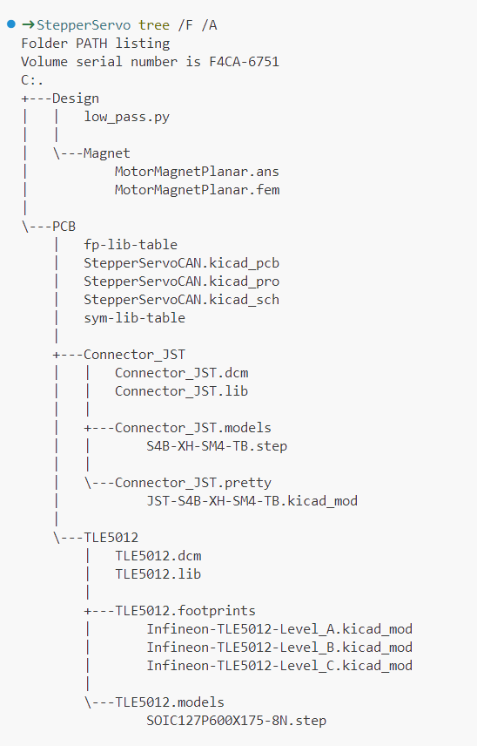


When you take over a legacy project
Notes:
There’s a saying: “Code is not an asset; it’s a liability.”
When you take over a legacy project, no matter software or hardware , you will start to have a headache.

Slide 7
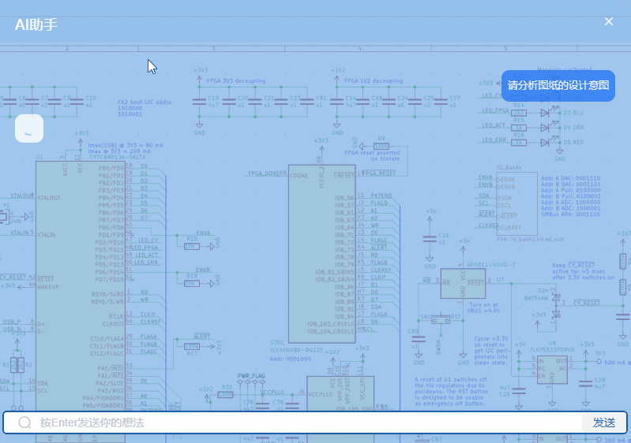
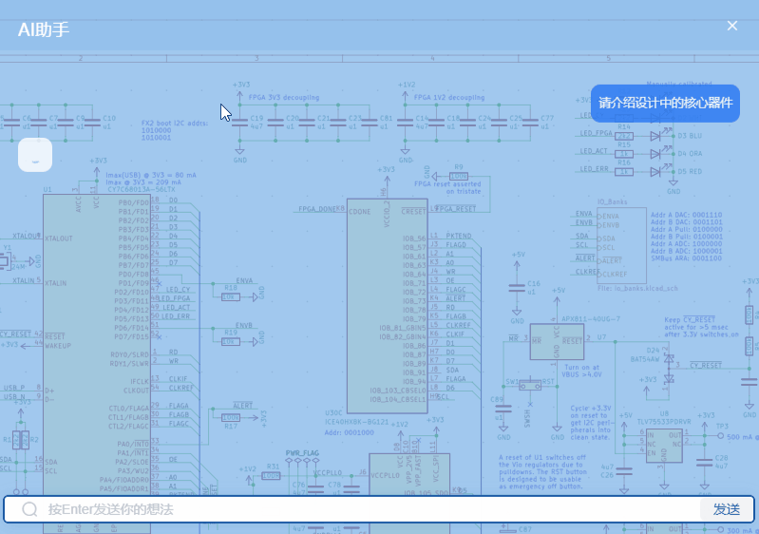

AI Saves Your Hair: Master Designs, Skip the Hassle
Notes:
With our AI-empowered ECAD-Viewer, you can quickly understand both the design’s intent and its core components.

Slide 8

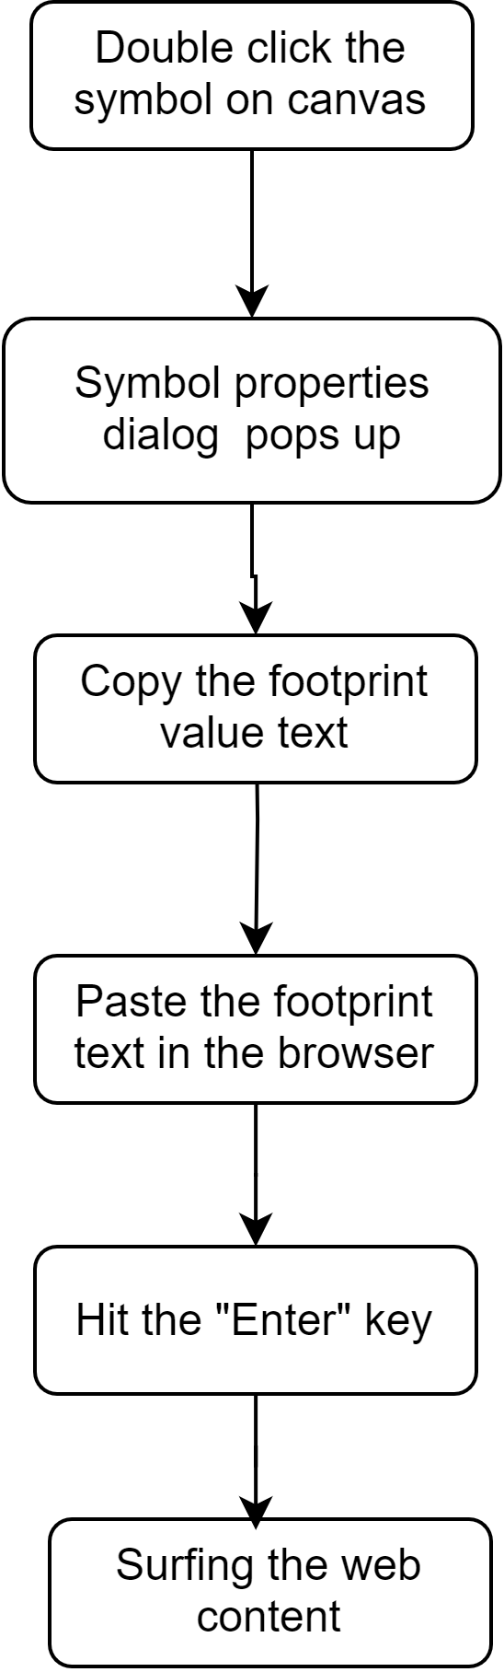

Steps to Find Specifications for a Symbol
Notes:
The diagram on the left is the SOP somewhere in a training course for finding the specs for a symbol.
Typically, you’d select the symbol and copy paste its footprint into a browser.

Slide 9
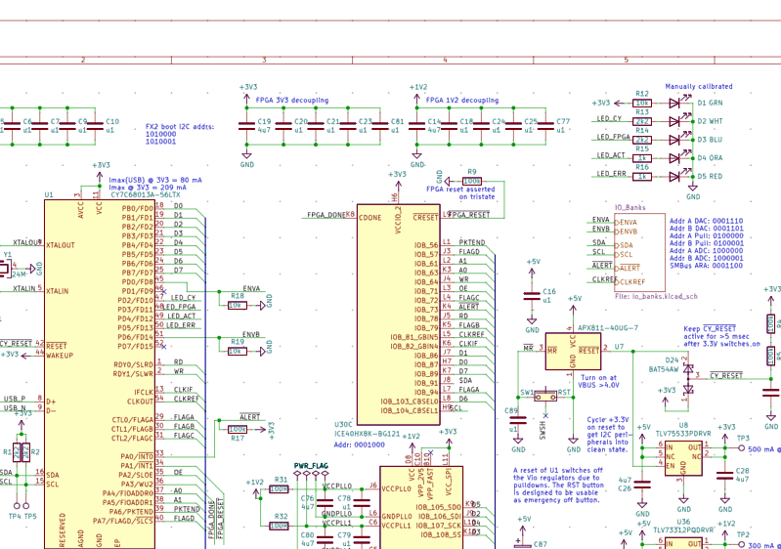
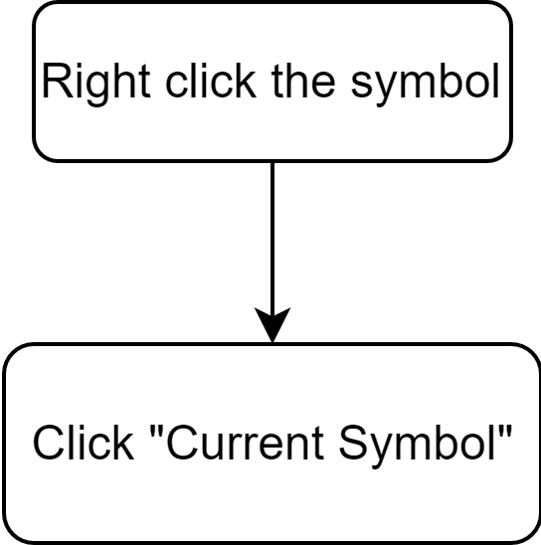

Steps to Find Specifications for a Symbol with AI
Notes:
With our AI assistant, you just right-click the symbol and select "Current Symbol."

Slide 10
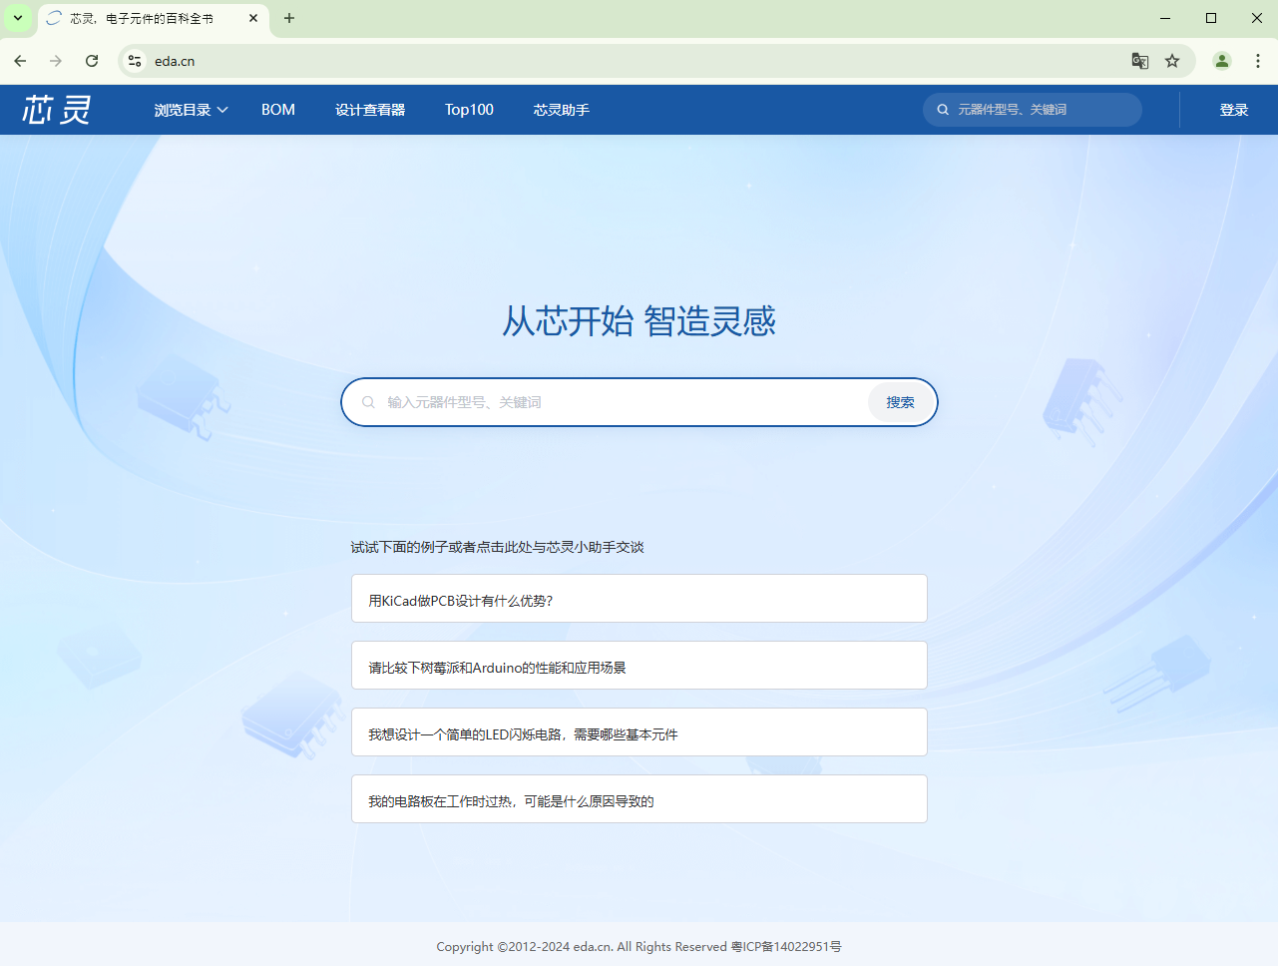
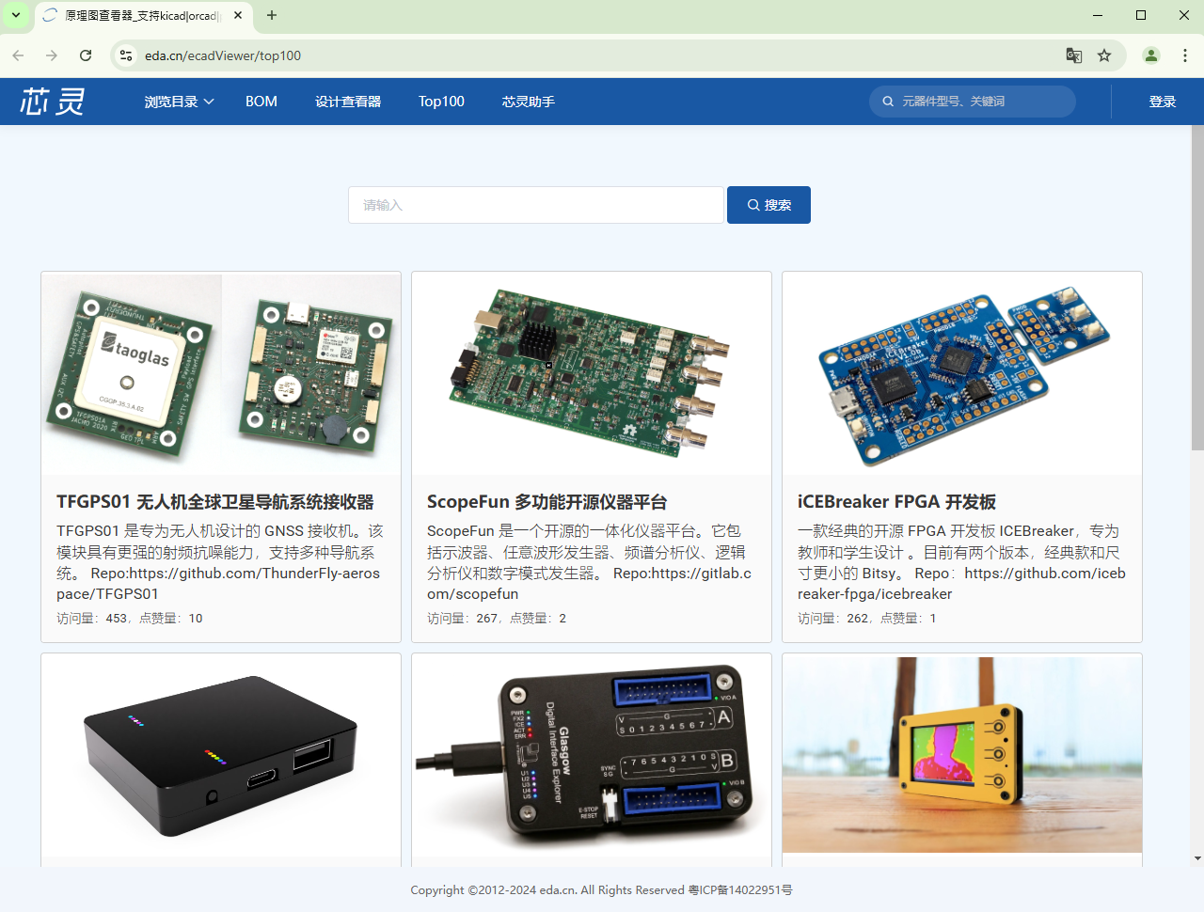
Ways to Explore ECAD-Viewer
Upload and view your own designs directly in the design viewer
Discover And Explore popular designs through the TOP 100
https://www.eda.cn/ecadViewer
https://www.eda.cn/ecadViewer/top100
Notes:
There are two ways to experience ECAD-Viewer:
- Upload and view your own designs directly in the viewer.
- Discover popular designs in the TOP 100 showcase.

Slide 11
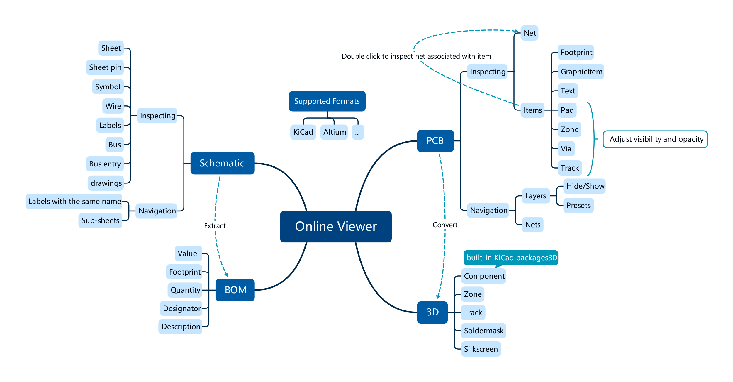
Notes:
You can interact with all design elements and inspect their properties.
A complete 3D model can be rendered even without a STEP file if all footprints reference the KiCad package3D library.
Both KiCad and Altium Designer files are displayed properly through a conversion pipeline.

Slide 12
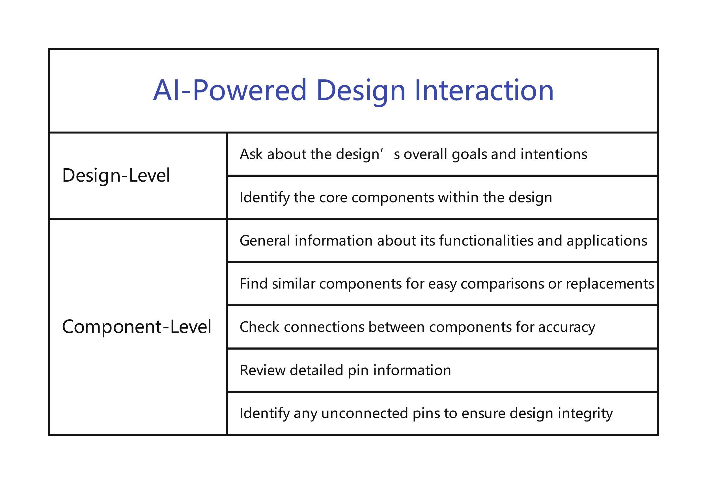
Notes:
In addition to design-level queries, you can access more options for components, such as finding replacement parts and checking pin connectivity.

Slide 13
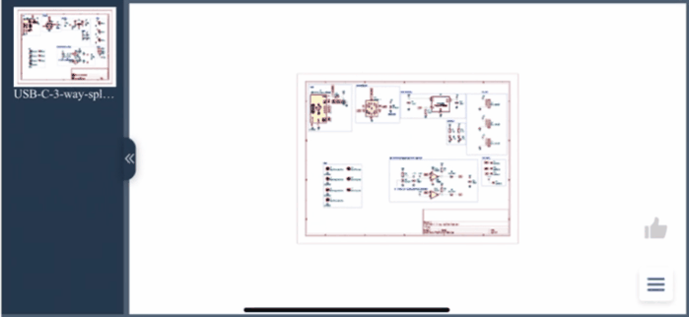
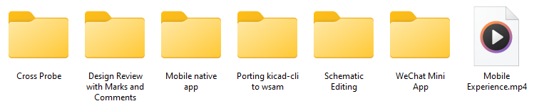
RoadMap
Notes:
We plan to introduce features like cross-probing, design comments, schematic editing, and more.
Currently, we’re making progress on mobile experience, although they’re still under internal testing.

Slide 14
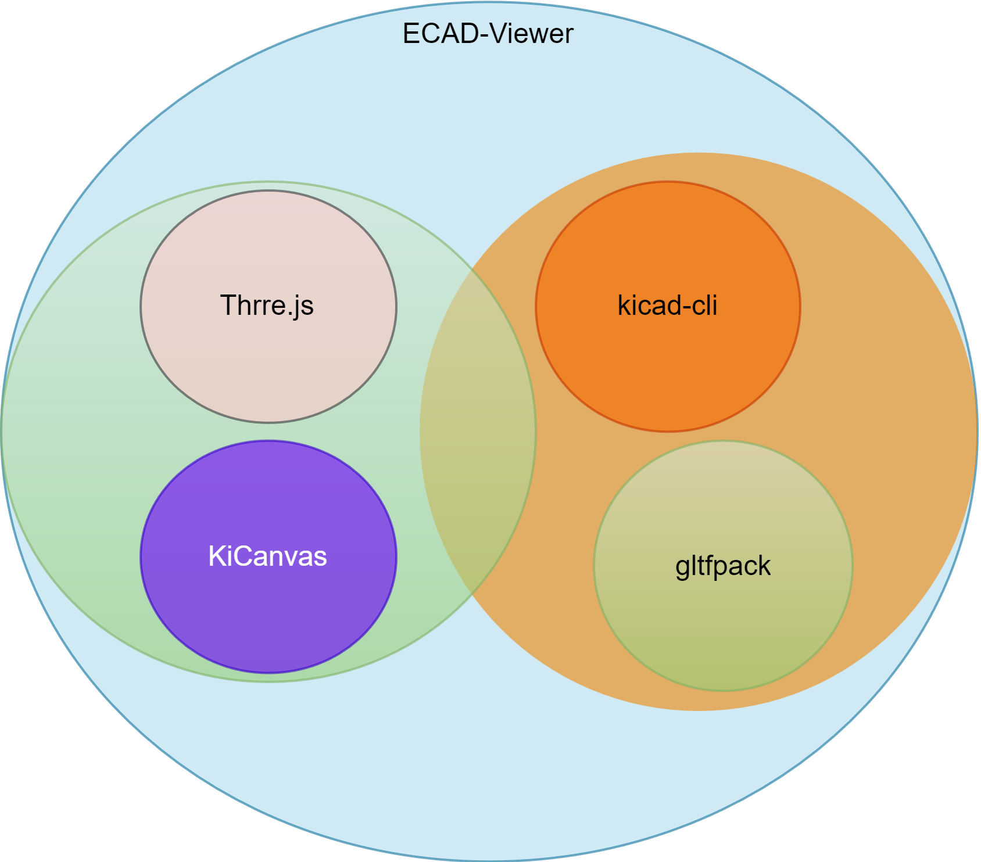
Core Components of ECAD-Viewer
kicad-cli : Converting AD designs to kicad designs, and converting .kicad_pcb to .gltf as well
gltfpack : Compressing the gltf file
KiCanvas: Rendering the .kicad_pcb and .kicad_sch
Three.js: Rendering the gltf
Notes:
To support both KiCad and Altium designs and convert PCB to 3D, ECAD-Viewer leverages `kicad-cli` while expanding on KiCanvas. We use `gltfpack` to compress GLB files, ensuring smooth 3D display in Three.js.

Slide 15
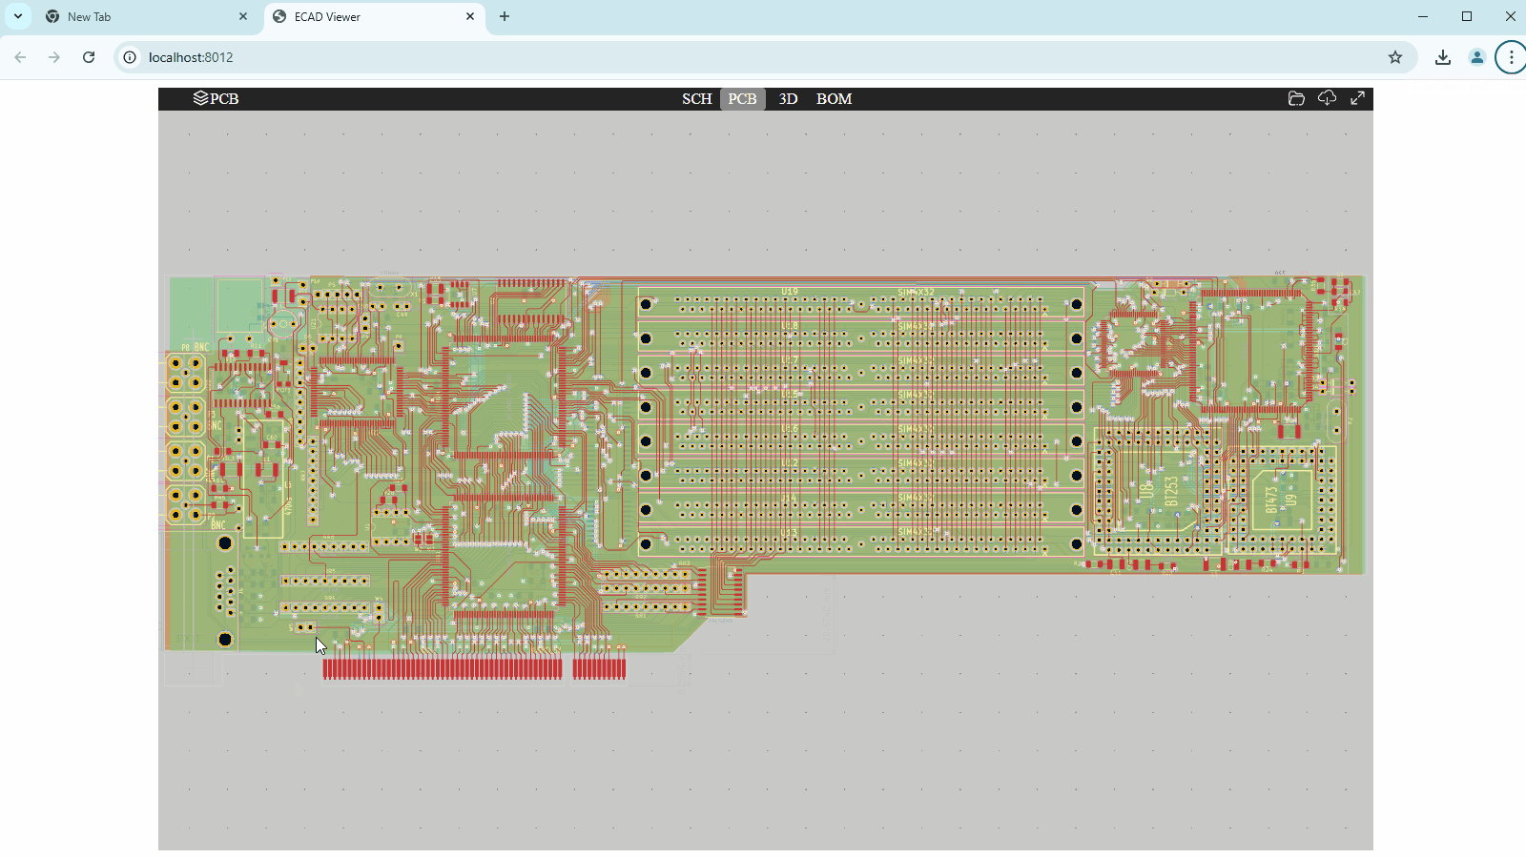
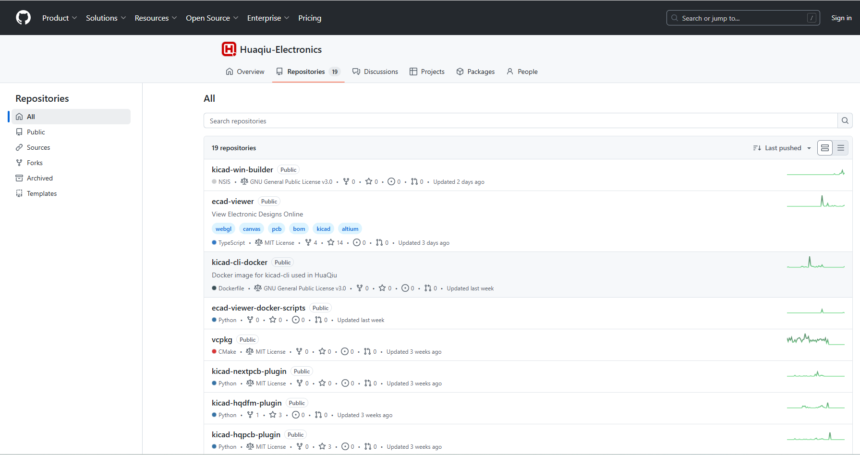
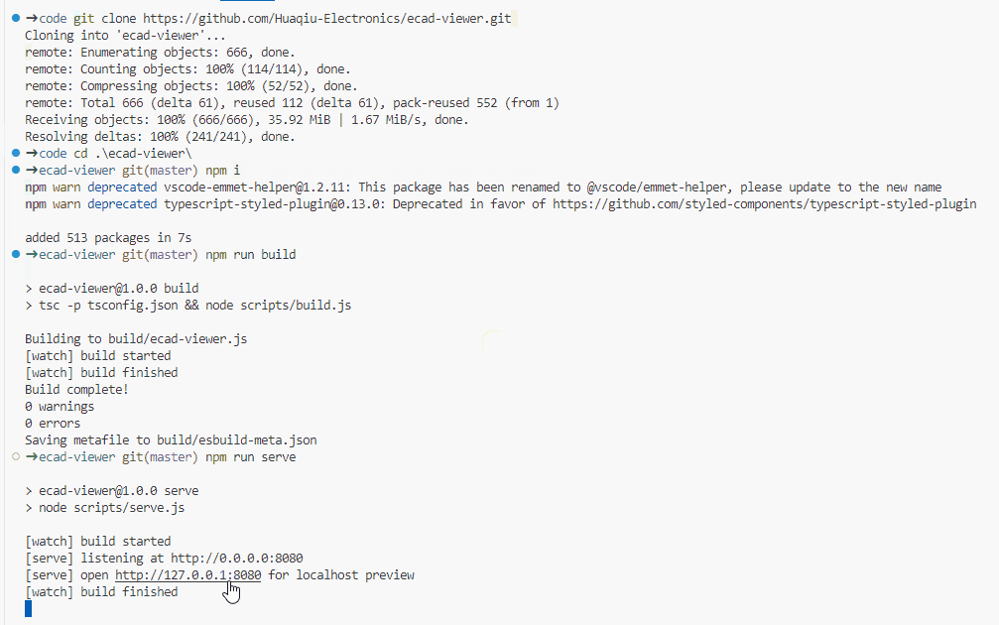
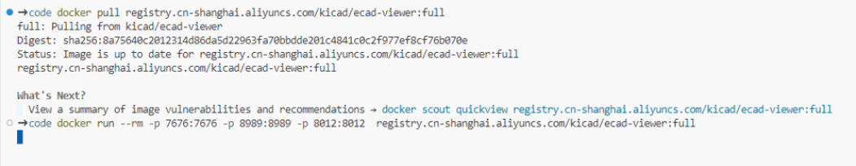
Integrating ECAD-Viewer To Your Website
Notes:
To embed ECAD-Viewer on your website, you can either build it from source or use the pre-built Docker image.

Slide 16
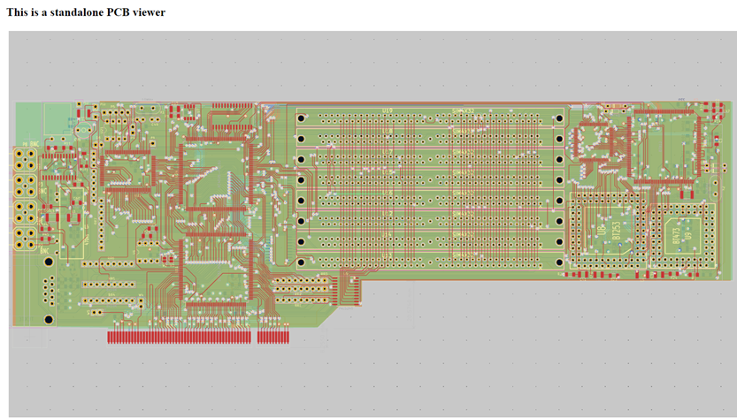
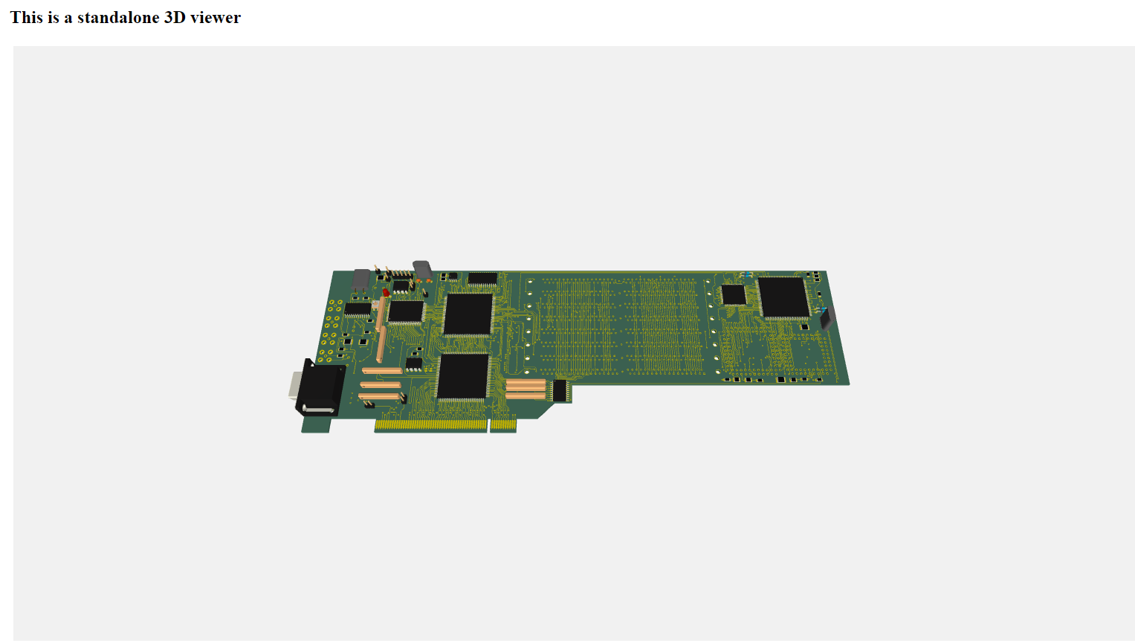
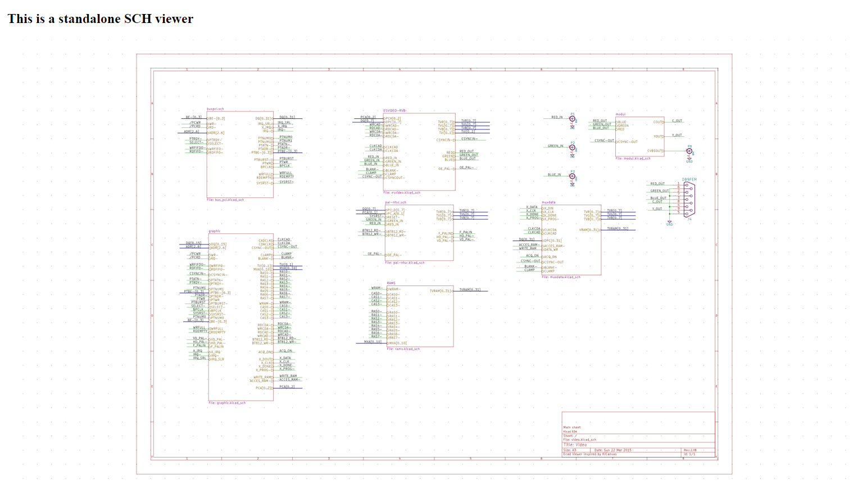
Integrating ECAD-Viewer To Your Website
https://github.com/Huaqiu-Electronics/ecad-viewer/blob/master/debug/embedded.html
Notes:
You can also embed individual viewers by following the embedded demo in the repository.

Slide 17

Blind coding
Those who ignore open source are coding with their eyes closed.
Notes:
I once worked with an engineer, Mr. Zhang, who believed in building everything from the ground. He used to say, “Developers today can’t write a single line of code without GitHub.”. Mr. Zhang resisted new tools and open-source advancements, disliked code with modern C++ features like lambda expressions from C++11.
Recently, I heard he moved into project management rather than coding.

Slide 18
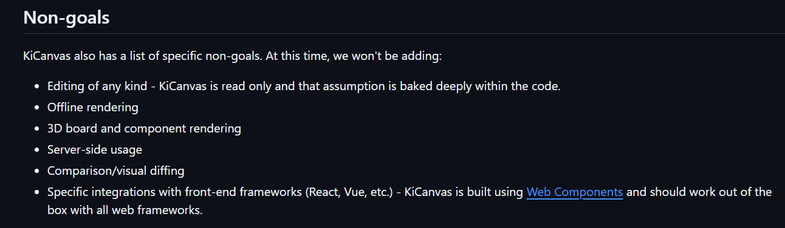
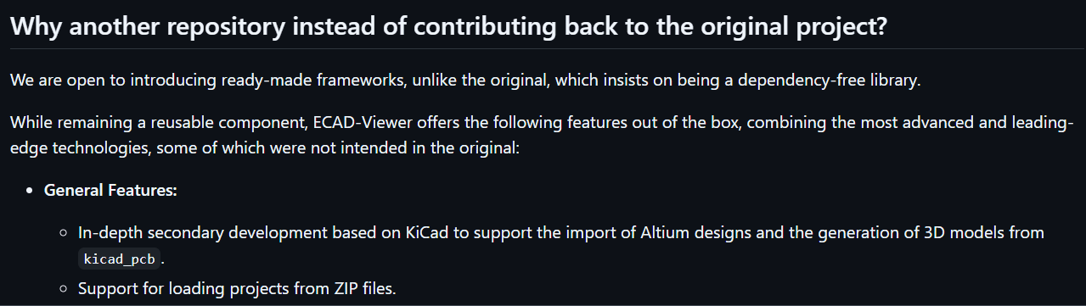
Expanding on KiCanvas
https://github.com/theacodes/kicanvas/blob/main/docs/docs/roadmap.md
https://github.com/Huaqiu-Electronics/ecad-viewer/blob/master/README.md

Slide 19
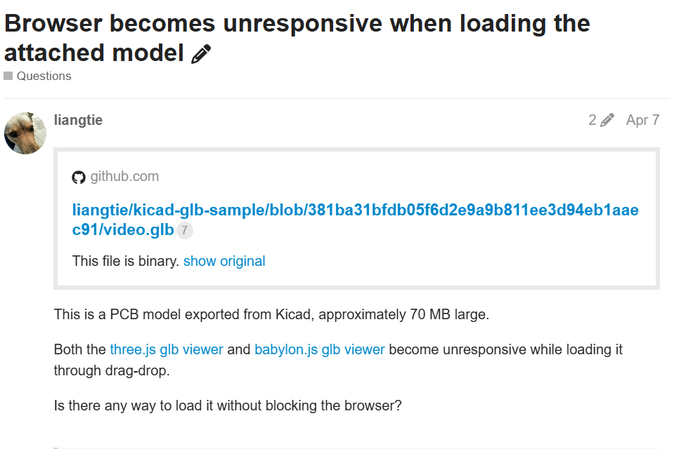
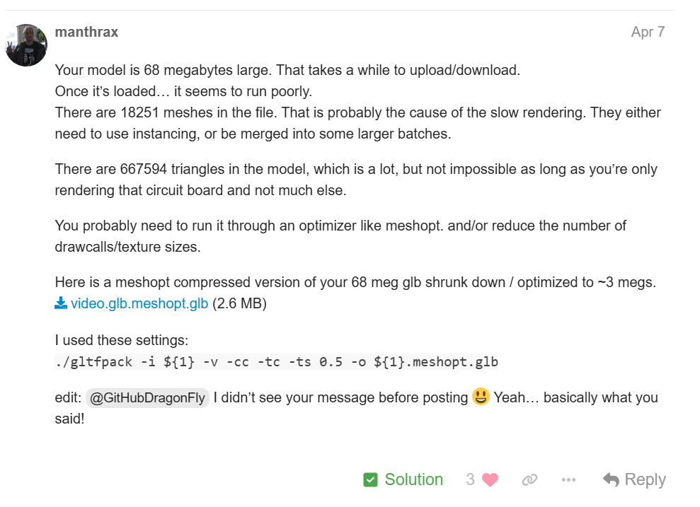
Being Advised to introduce gltfpack to compress glb

Slide 20
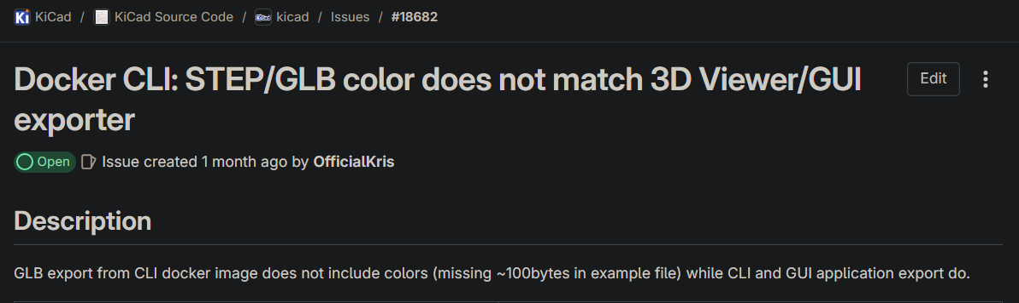
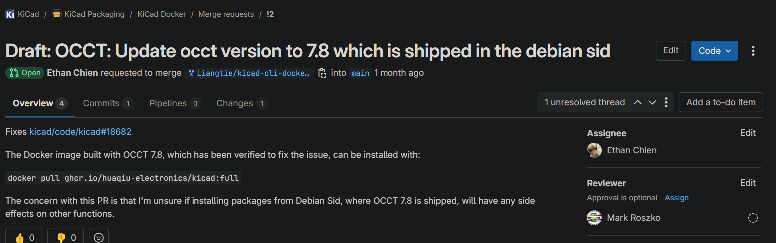
Fixing GLB Missing Color
OCCT 7.6
OCCT 7.8

Slide 21
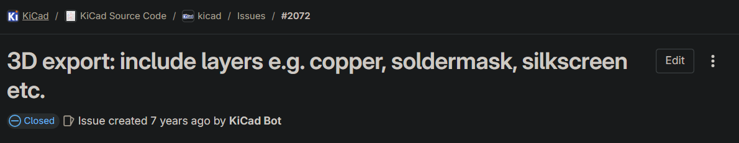

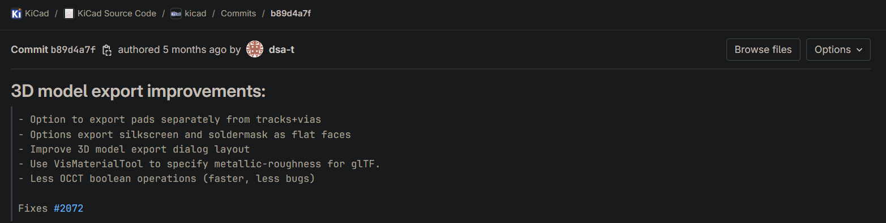
Receiving 3D model improvements

Slide 22
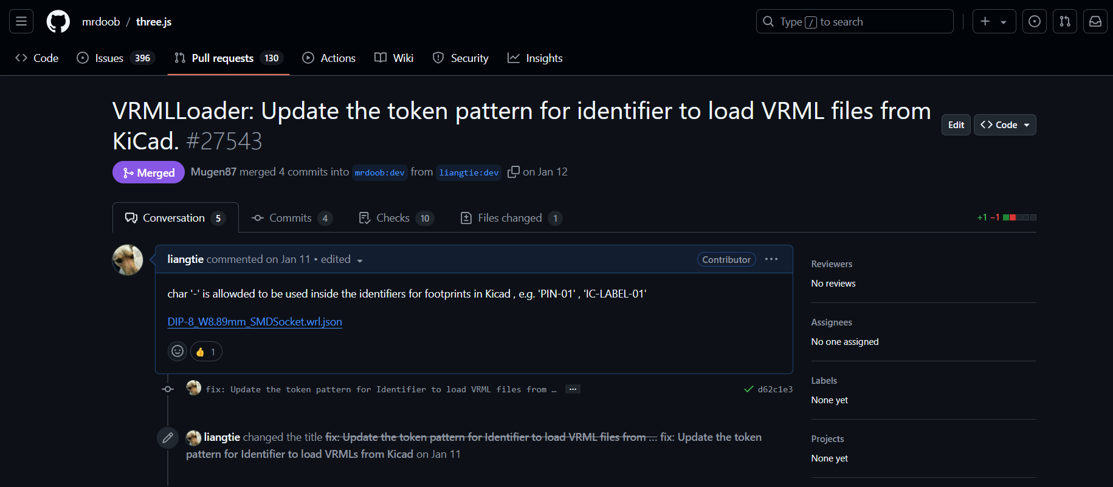
Contributing Fix to the VRMLLoader

Slide 23
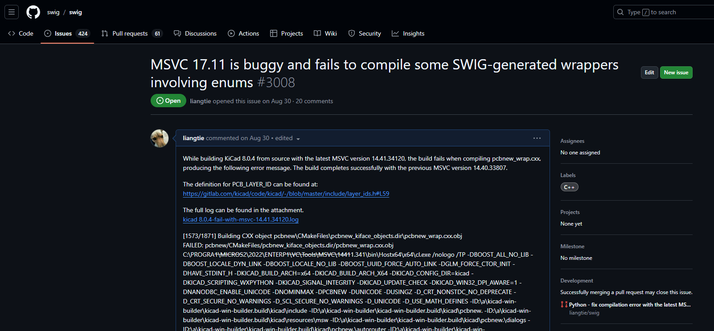
Issuing bug with MSVC to the SWIG project

Slide 24
Questions?
Notes:
Let’s explore ECAD-Viewer’s features by uploading either KiCad or Altium designs.
1. Schematic Viewer
- The main canvas displays the root schematic by default, with previews of all sheets in the left-side navigator and a properties panel on the right.
- Clicking on a schematic preview opens it in the main panel.
- Left-clicking on the canvas selects an item, updating the properties panel with details.
- You can inspect properties of all schematic items, including symbols, sheet symbols, and sheet pins.
- Double-clicking a sheet symbol on the canvas opens it in the main panel.
- Left-clicking a label shows a menu with shortcuts to labels of the same name; selecting an entry navigates to the corresponding label.
- Right-clicking on the canvas space reveals options to explain design intentions or show core components.
- Right-clicking a symbol shows options to check its functionalities, replacements, pin details, and pin connections.
2. PCB Viewer
- Left-clicking on the canvas allows you to inspect all PCB items.
- Double-clicking an item highlights the selected footprint or its associated net.
- You can switch between nets in the net navigator on the left.
- The layer navigator lets you show or hide individual layers or use presets like front, back, or inner coppers.
- You can adjust opacity for zones, pads, vias, and tracks, and hide footprint references and values as needed.
3. 3D Viewer
- Zoom or rotate the 3D model with the left mouse button, and pan with the right mouse button.
4. BOM Viewer
- Displays all components in the design, grouped by footprint with quantities shown.

Slide 25
ECAD Viewer Development and Integration Insights: A Journey Through the Open Source Community
THANK YOU
Ethan Chien
Intelligent Manufacturing Center, Huaqiu

